Slide 1
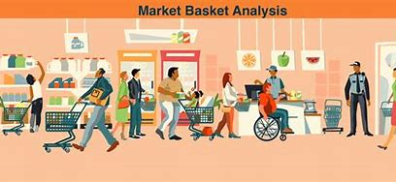
capstone project MARKET BASKET ANALYSIS

Slide 2
CSA1360-THEORY OF COMPUTATION
FACULTY NAME: DR. R. LATHA
GROUP MEMBERS:
K. MANJUNATH NAIDU
(192211469),
V. PURUSHOTHAM
(192210742),
N. THARUN
(192211227).

Slide 3


Introduction :
Market Basket Analysis is a data mining technique used by retailers to understand the purchasing behavior of customers. It involves analyzing the items that are frequently bought together to discover patterns and associations. This enables businesses to optimize product placement, cross-selling, and promotional strategies.

Slide 4
Definition and Concept of Market Basket Analysis
Concept
Definition
Market Basket Analysis is the process of discovering associations between items in transactional data. It helps in uncovering patterns and relationships which can be used for decision-making.
The concept involves identifying co-occurrence of items in transactions and establishing rules to understand the buying patterns of customers.

Slide 5

Importance and Benefits of Market Basket Analysis
Customer Insights
Increased Revenue
Inventory Management
Market Basket Analysis provides valuable insights into customer behavior, preferences, and correlations between products, leading to improved marketing strategies.
By understanding which products are commonly purchased together, businesses can optimize bundling, pricing, and promotional strategies to increase sales and revenue.
It helps in efficient inventory management by identifying product affinities, reducing stockouts, and optimizing stock levels.

Slide 6

Steps Involved in Market Basket Analysis
1
Data Collection
Collect transactional data containing the list of items purchased by customers.
2
Itemset Generation
Identify all unique combinations of items purchased in the transactions.
3
Association Rule Mining
Discover the association rules between the items in the transaction data.

Slide 7
Data Preprocessing for Market Basket Analysis
Data Cleaning
Transaction Encoding
Redundancy Removal
Perform data cleaning to handle missing values, outliers, and inconsistencies in the transactional data.
Encode the transaction data in a suitable format for association rule mining, such as the One Hot Encoding technique.
Eliminate duplicate transactions and reduce redundancy to ensure accurate analysis.

Slide 8

Association Rule Mining Algorithms for Market Basket Analysis
1
Apriori Algorithm
2
FP-Growth Algorithm
One of the most widely used algorithms for discovering association rules. It uses a level-wise approach to find frequent itemsets.
An efficient algorithm for mining frequent patterns without generating candidate sets, leading to better performance.
3
ECLAT Algorithm
Focuses on vertical data format and is known for its high performance in sparse datasets.

Slide 9




Evaluation Metrics for Market Basket Analysis
Support
Indicates the popularity of an itemset in the dataset.
Confidence
Reflects the reliability of the association rules and measures the likelihood of the consequent item being purchased given the antecedent item.
Lift
Measures the strength of a rule and indicates how much more likely the consequent is purchased compared to its prior purchase rate.

Slide 10

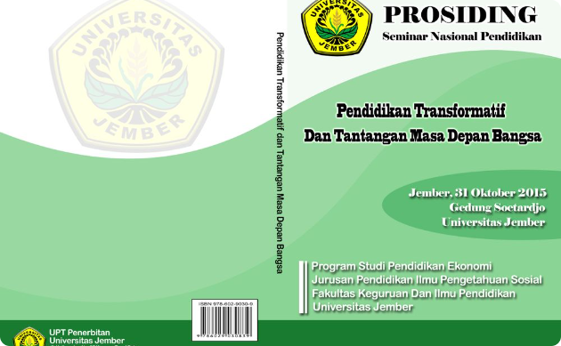
Real-World Applications of Market Basket Analysis
Retail Industry
E-commerce
Used to optimize store layouts, product placements, and cross-selling strategies to enhance customer experience.
Utilized to recommend products, personalize customer experiences, and improve product bundling based on customer preferences.

Slide 11

Challenges and Limitations of Market Basket Analysis
Data Sparsity
Complexity
Dynamic Behavior
In datasets with a large number of items, finding meaningful association rules becomes challenging due to the sparsity of data.
Analyzing large transactional datasets and identifying relevant patterns may become computationally complex and time-consuming.
Changing consumer preferences and market dynamics require continuous updates to the analysis and rule sets.

Slide 12
Conclusion :
Market Basket Analysis plays a crucial role in understanding customer behavior, enhancing sales strategies, and improving business decision-making. By uncovering meaningful associations, businesses can enhance customer satisfaction, increase revenue, and adapt to changing market trends.

Slide 13


